Slide 1
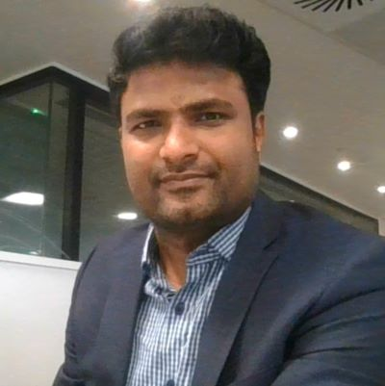
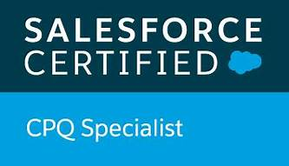
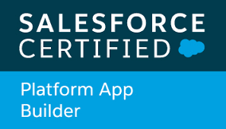
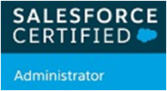





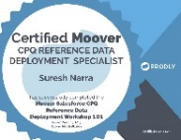
Suresh Narra
Ph- +44-7448623159
Role
Sr Technical Consultant
Active Credentials
Salesforce Certified Administrator
Salesforce Certified App Builder
Salesforce CPQ Specialist
Certified Moover (Prodly) CPQ Reference Data Deployment Specialist
Trailhead Super badge: Salesforce CPQ Admin Fundamentals
Trailhead Super Badge: Discover Sales Cloud
Trailhead Super Badge: Salesforce CPQ and Billing
50 Trailhead Badges with 50,000 points
Apttus Quote to Cash Certified
Apttus 201 CPQ Essential Certification
Apttus 202 CPQ Advanced Certification.
Apttus CLM Trained.
MuleSoft, SnapLogic, Boomi, Informatica: API design, Anypoint Platform, connectors (HTTP, Salesforce, Database, etc.).
Acquired Certificate in SAP CRM.
Acquired certificate in SAP Vistex for Incentives Administration & Configuration
Trained in SAP ABAP.
Professional Experience
20 years of experience and experienced Sr Technical Consultant with a robust background in implementing and optimizing Salesforce, SAP solutions and MuleSoft. Specializing in Quote/Lead/Order to Cash in Sales Cloud, APEX, CPQ, and Service Cloud, alongside significant expertise in SAP ECC, SAP CRM, and SAP ABAP.
Proven success in delivering high-impact solutions across various industries, contributing to the digital transformation of leading global organizations like Adobe, Thomson Reuters, Refinitiv, and London Stock Exchange Group (LSEG).
Key Engagements Delivered :
LSEG Transformation Program (Quote to Cash & License Management), CRM and Finance system unification and migration : End to End Solution Architect on Salesforce, SAP, License Management Systems, Integration Platform for QTC transformation project.
Responsibilities team's End to end Solution designed based on Salesforce to add lot more flexibilities with attribute-based Pricing, Automated Contract Subscription based Operations and approvals. Transformed and migrated the existing Siebel assets into Salesforce CPQ subscriptions.
Design and Development of custom License Management modules for Multiple automated and manual fulfillment systems.
Key projects worked in Refinitiv: - Third party portal, Genesis, GRC Migration to TRUST.
Lead Solution designer for Refinitiv Third party portal, Fulfillment, GRC Integration projects.
Responsibilities include providing designing alternatives and best practices, conducted collection and analysis of functional, technical, and non-functional requirements. Architect and design the trigger components framework, Common VF page framework and error Handling framework for the project.
Lead Salesforce Technical Consultant for Adobe Territory Assignment and Compensation project. Responsibilities include auto mate the sales team assignments for Account and Opportunities, correct sales visibility, reduced error rates, accurate pipelines and comp layouts, better reporting, streamlined processes across different team's hand-off and scalability.
Lead Salesforce Technical Consultant for Adobe for Enterprise Lead to order (ELO) Project. Responsible for creation of new processes pertaining to products, orders, entitlements and integration between SAP and Salesforce using REST and SOAP based API services and providing functional and technical documentations including solution design and process flow documentation
Senior SAP Technical Consultant for Adobe for Macromedia Data migration, SAP Upgrade projects. Responsibilities include requirements workshops, implementation plan and testing scripts, migrate the Business Partner, Registration, Contracts, and Case data from legacy systems to SAP CRM system, created new utilities for updating profit centers on open order/line items.

